Slide 1
Abnormal electricity bills
Team
Security squad

Slide 2
Problem statement
INTRODUCTION
The reason for abnormal electricity bills because of the human error .The error occurs when the lineman doesn’t record the actual units.These human error may effect the consumer or the government.For example: When the consumer is charged more than the actual units he used, then the consumer is at loss.Likewise when the consumer is charged less than the actual units he used,then the government is at loss.

Slide 3
SOLUTION
In order to avoid/solve these problems, we will use smart meters . All the details of an electricity bills like recordings , units etc.. are stored in the blockchain according to the human consumption.
Blockchain consists of two organizations:
1)consumer
2)Southern power distribution company of Telangana Ltd.
At the end of the month , the blockchain produces the verified bill according to the units consumed by the consumer . To check whether the units are valid or not ,the smart contractor is used.
Smart contractor contains all the details regarding the units consumed by the consumer according to the power government ,it gives the unique id to each meter ,by checking the id it allows only the valid units to the bill . So by using this smart contractor we can avoid the human error.

Slide 4
FABRIC COMPONENTS
1)POWER CORPERATION:
It is a company which is use to supply and generate electricity. It also performs a public service, subject to government regulation.
There are types of power corporation ,
they are EXPRESS POWERS,IMPLIED POWERS,INCIDENTAL POWERS.
2)SMART METERS VENDORS:
Genus Power Infrastructures Ltd. Is the leading smart meter manufacturer in India , using proprietary technology to develop innovative and customized meter solutions for utility and energy boards.
3)GOVERNMENT POWER ORGANIZATION:
In this organization they frame regulations for power generators (government and private),transmission utilities and the distribution companies in their areas of jurisdiction

Slide 5
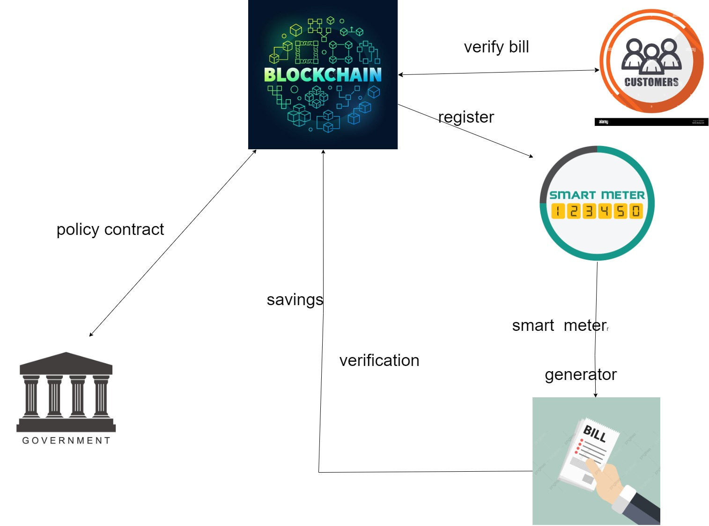
HIGH LEVEL FLOW

Slide 6
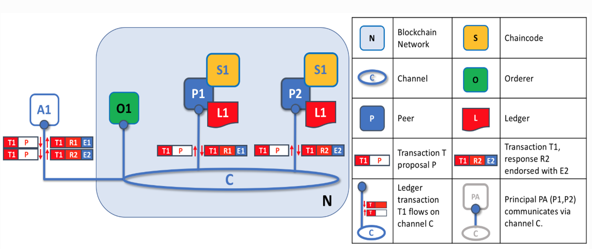

Slide 7
Pseudo code
SMART CONTRACTS
generate electricity bill
calculate(units, meter_address)
{
location = getMeterLocation(meter_addres);'
unitPrice = getPricePerUnit(location);
totalBillPrice = units * unitPrice;
saveBill(totalPrice, user);
}

Slide 8
Thank you

